Slide 1
Science Synergy Science + Fun + Team Spirit
Proposal for a partnership
between
iPraxis and Science Synergy
and
The Science Synergy
Middle School Invitational
Tournament, Science Day,
and related STEM events

Slide 2
Overview: Science Synergy
Science Synergy is a non profit group dedicated to encouraging Philadelphia Middle School students to pursue interests in science. It is a high school student led effort.
Mission
To spread excitement about exploring various topics of STEM
To create a cooperative, fun, friendly intermural program for students interested in STEM
To identify and cultivate potential future scientists
To encourage students to approach science in class and outside of school with more enthusiasm

Slide 3
Proposal: Science Synergy Middle School Invitational Tournament
Harriton High School science students organize a STEM tournament under the name of Science Synergy, consisting of selected competitive “events” that are chosen to best suit participants’ abilities for success.
Notes:
***NOTE: Science Synergy has NO AFFILIATION with Science Olympiad. The majority of the executive committee members are part of the Science Olympiad program, but there is no connection to the national Science Olympiad program.

Slide 4
Teams and Schools
A team of interested middle school students (5-8) will represent each iPraxis school on the day of competition.
The schools involved will be:
1. Belmont Charter School (1-8)
2. Cook-Wissahickon Elementary School (K-8)
3. Henry C. Lea Elementary (Pre K -8)
4. Northwood Academy Charter School (K-8)
5. Martha Washington Elementary (K-8)

Slide 5
Science Synergy Tournament Events
There will be a select number of “events” that cover STEM topics. Each event is an individual category of competition.
- Team and individual events
Teams prepare for events throughout the school year, provided a set of given rules prior to day of competition
We would like to create events that integrate school curriculum material. While preparing for the Science Synergy tournament, students would also be studying for science, math, technology education classes as well.
These events would also focus on team building skills and cooperation
Notes:
Team events and individual events

Slide 6
Examples of Possible Events
Science Relay- Students have to correctly answer science questions and perform group physical activities
Bottle Rockets- Constructed from 2 liter soda bottles. They are launched as a result of high water pressure build up in the pressure launcher.
Algebra Challenge- Tests students on algebra skills in a fun and cooperative manner
Science Pictionary- Pictionary based on science class vocabulary terms

Slide 7
Role of Science Teachers
Encourage students to participate, team spirit
Encourage students to attend Science Synergy presentations/promo videos at schools
Help with integrating school curriculum material
Ex: Providing lists of vocabulary terms, info about curriculum, topics for school tests, etc.
Provide encouragement and support
Provide input, give suggestions for activities
Assistance in determining appropriate level of difficulty for the activities

Slide 8
Measuring Success
Obtaining the maximum number of students as possible, hopefully at least 8 per school team.
Students take a post surveys on the Science Synergy Website determining the effectiveness of the event.
Executive committee members will compare results of surveys and plot graphs, make charts to create a progress report that will be posted on the website.
Observing positive changes in school and state test results that cover STEM topics

Slide 9
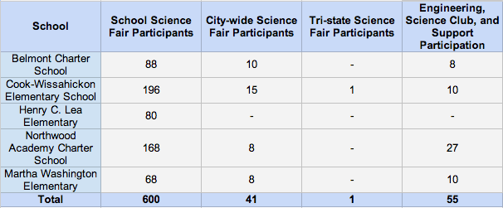
iPraxis Progress Report Chart

Slide 10
Proposal: Science Day
Science Day: Harriton Science Club members set up booths at a TBD location, science classes sign up for different time slots and view science demonstration, shows throughout the day.
Mission
Encourage interest in science for not only students interested in science, but for all students (K-8).
Increase student involvement in the Science Synergy Invitational Tournament
The Glowing Hot Dog
Demonstration
Flame and Lycopodium Power Demonstration
Van de Graaff Generator

Slide 11
Role of Science Teachers
Have students view promotion video(s), presentations
Sign up class for Science Day
Liquid Nitrogen Demonstration
Flame Waves

Slide 12
Measuring Success
Obtaining a substantially large number of participants (~ 5 classes)
Students take pre and post Science Day surveys
Executive committee compares results, prepares report
Have an increase in the number of students willing to participate in the Science Synergy Tournament
(Science Day would take place before Science Synergy Tournament)

Slide 13
Next Step
Create a timeline based on Harriton and iPraxis schools’ calendars
Determine interested teachers to take part of Science Synergy program
Reach out to schools and work with teachers to identify potential candidates for Science Synergy teams
Make contact lists for possible executive and advisory committee members
Create a website providing information for participants, teachers, sponsors
Post notices for upcoming events (both Sci. Syn. Tournament and Science Day
Tutorial videos, forums for students to receive help and ask questions from executive committee members (high school students)
Notes:
Explain executive and advisory committees

Slide 14
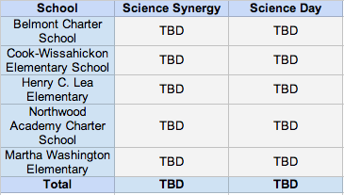
Conclusion
Science Synergy Invitational Tournament: Partnership between iPraxis and Science Synergy to host a middle school STEM-related tournament in an effort to nurture talent and interest in STEM topics
Science Day: Science Synergy arranges a Science Day for students of all ages, in which high school students provide demonstrations and explanations of various scientific phenomena
Goals: Spread interest in
STEM topics, encourage
students to pursue STEM
Interests, and view positive
trends in approach to science
in school and independently
Notes:
We aim to

